Slide 1
ArcelorMittal
Service Group Sp. z o.o.
Poland
PRESENTATION OF THE COMPANY
www.amservicegroup.pl

Slide 2
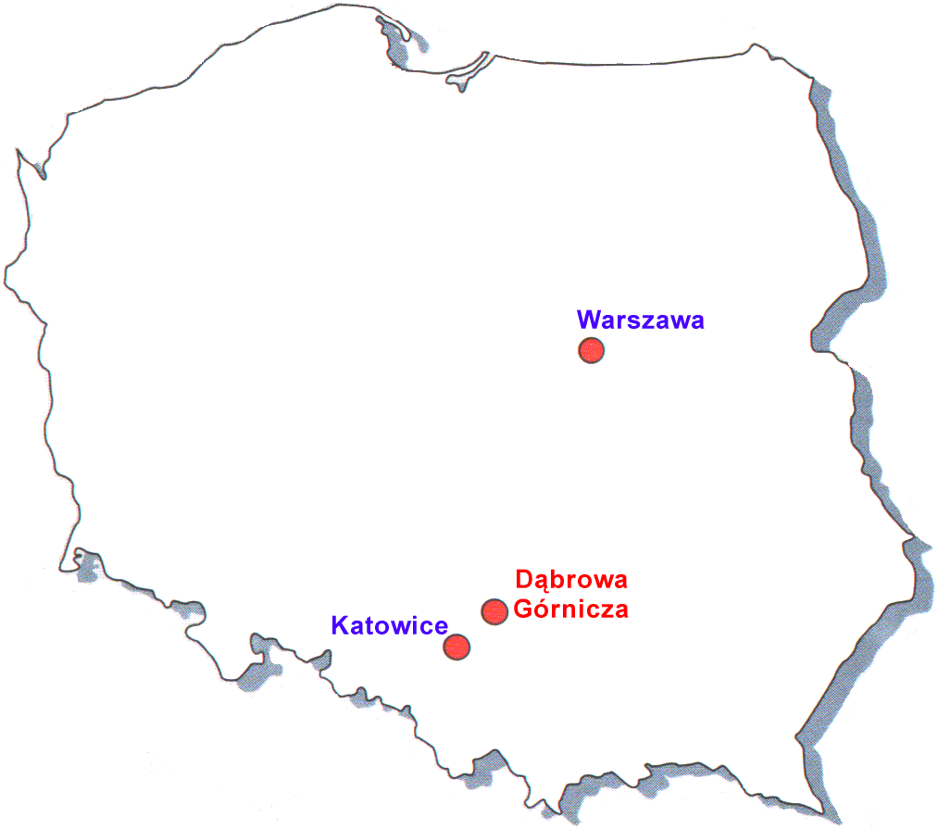
GENERAL INFORMATION - LOCATION
ArcelorMittal Service Group Sp. z o.o.
Head Office
Al. J. Piłsudskiego 92
41-308 Dąbrowa Górnicza
phone +48 32 7956 100; +48 32 7956 300
fax +48 32 7956 302
www.amservicegroup.pl
amsg.marketing@arcelormittal.com

Slide 3
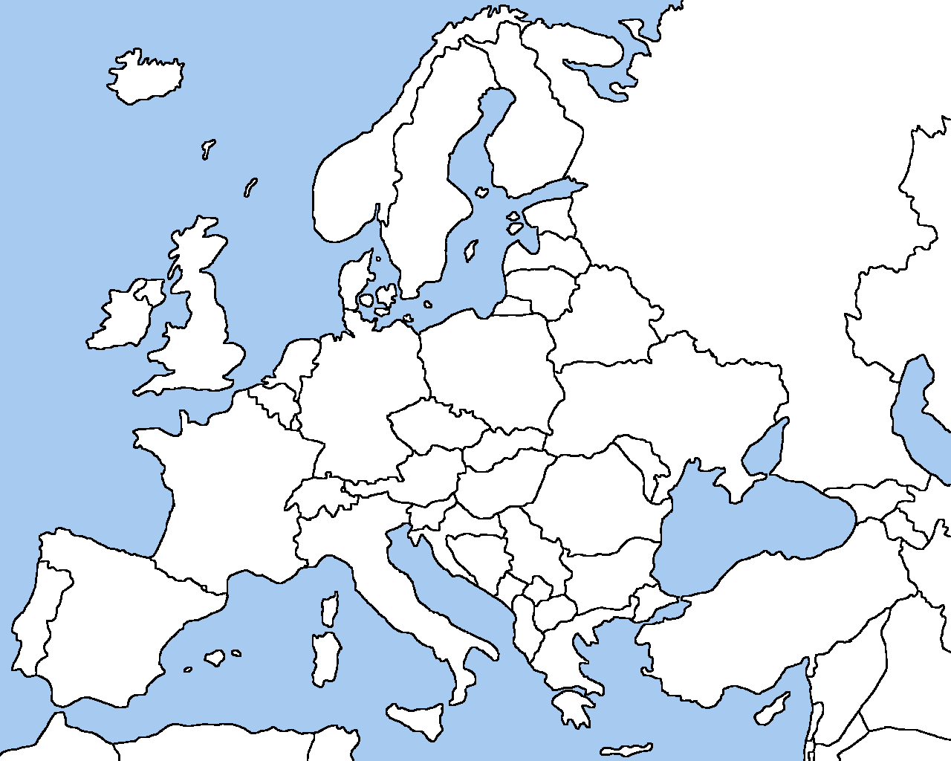
ArcelorMittal sites in Europe cooperating with AMSG
AM Bremen
AM Eisenhuttenstadt
AM Ruhrort
AM Liege
AM Poland
AM Florange
AM Ostrava
AM Gandrange
AM Asturias / Gijon
AM Olaberria
AM Fos-sur-Mer
AM Zaragoza
AM Sagunto

Slide 4
The scope of production covers:
SCOPE OF ACTIVITY
Specialization:
production and regeneration of spare parts for machines and appliances for
metallurgical and heavy industry
production of heavy steel structures
turn-key projects and realization of investments
spare parts, units, machines and equipment,
cutting and special-purpose tools,
instrumentation and process fittings,
machine and building constructions up to 50 t,
crane parts,
fan housings.

Slide 5
Types of machines and tools used:
SCOPE OF ACTIVITY
lathes: light, medium, heavy and very heavy lathes, vertical, CNC lathes,
boring machines: medium and heavy CNC WD/FCW 150
millers: light, medium and heavy, universal, planer mills, CNC types,
planers: longitudinal, vertical types including vertical slotters,
drillers: radial, bench, horizontal borers in light, medium, heavy types, jig borers, CNC drill centre,
grinders: light and heavy types for shafts, planers splines, threads, worms,
gear cutting machines: hobber millers, Maag slotters, Fellows slotters, gear wheel grinders
Messer plasma cutter

Slide 6
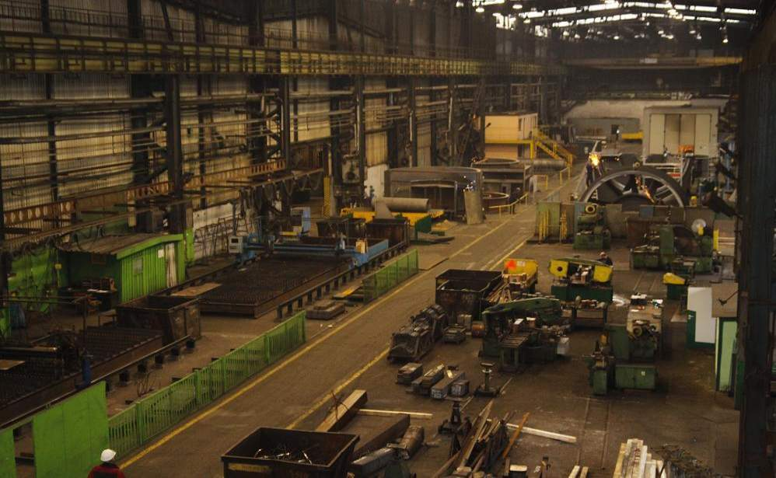
MECHANICAL WORKSHOP

Slide 7
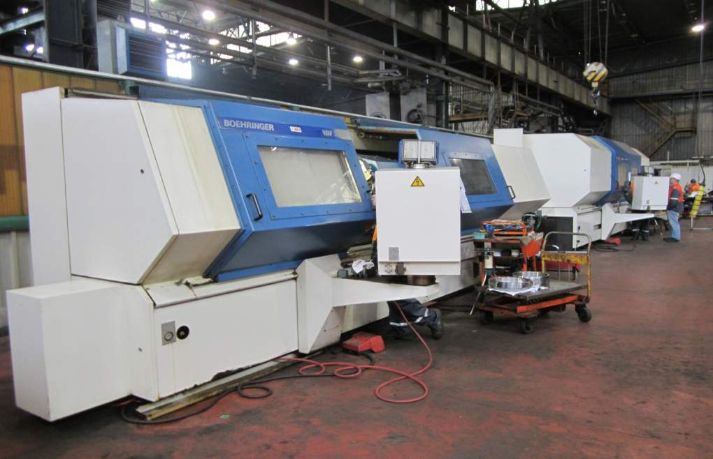
CNC MACHINES

Slide 8
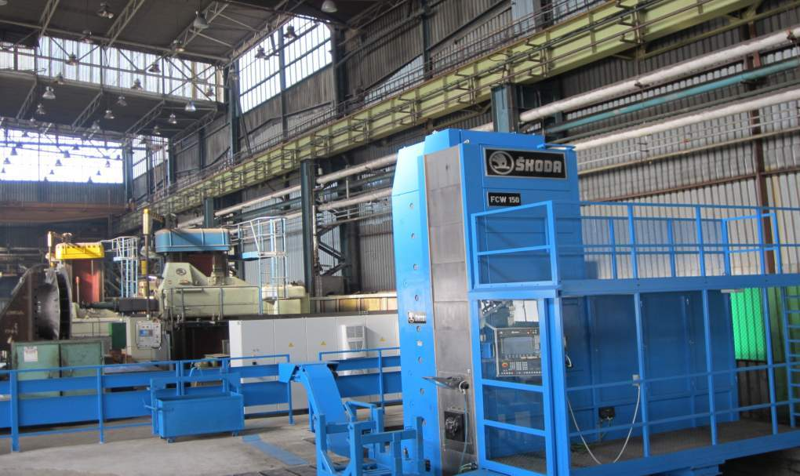
CNC MACHINES

Slide 9
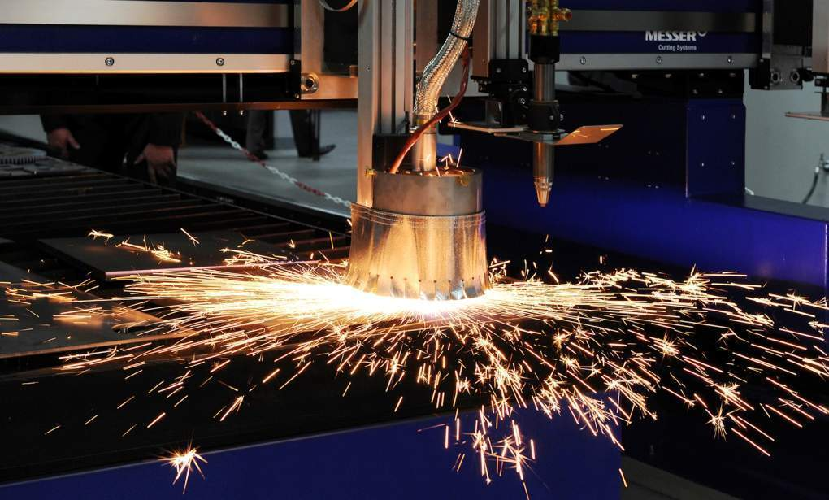
MESSER CUTTING MACHINE

Slide 10
Mechanical workshop - capacity
 | quantity
Small turning lathes | 26 | max Ø 2500, max length 10 000
Medium turning lathes | 8
Heavy turning lathes | 1
Super-heavy turning lathe | 1
Medium carrousel | 3 | max Ø 4200, max height 2500
Large carrousel | 1
Gate miller | 20 | 1400 x 440 x 1750 9000 x 2600 x 3000
Heavy gate miller | 1
Universal miller | 32
Small boring machine | 10 | max 1120 x 3200 x 2300 Ø 650 max 1600 x 5000 x 3000 Ø 1500
Medium boring machine | 3
Heavy boring machine | 3
CNC turning lathe | 3 | max Ø 700, max length 3000
CNC miller | 2 | max 1800 x 800 x 710
CNC boring machine SKODA WD160 | 1 | X 5000; Y 3000; Z 1700 mm
Other (grinder, toothed wheels, chiseling, drilling) | 56

Slide 11
Mechanical workshop - capacity
Steel structures |  | Welding method MIG, MAG, TIG, SAW, FCAW, up to 50t elements Messer CNC plasma cutting machine 3000 x 12000 mm Sand blasting elements 5000 x 5000 x 5000 SA 2.5 Cold bending of plates 12mm thick x 2000 up to 60mm thick x 350 Certified own welder training center
Regeneration |  | Disassembly, inspection, regeneration and assembly of steel making equipment Regeneration of CCM rolls, crane wheels, shafts etc by pad-welding

Slide 12
Mechanical workshop - CRANES
No. of cranes | Load-bearing capacity
4 | Q=5T
5 | Q=8T
7 | Q=12.5T
1 | Q=20T
7 | Q=32T
1 | Q=50T
1 | Q=80T
26 cranes with load-bearing
capacity from 5 – 80 T.

Slide 13
Main suppliers of raw materials by Country
PLATES:
Poland
Germany
Czech Republic
PLATES FOR SAW BLADES:
Poland
STAINLESS STEEL:
Poland
FORGINGS:
Poland
CASTINGS:
Poland

Slide 14
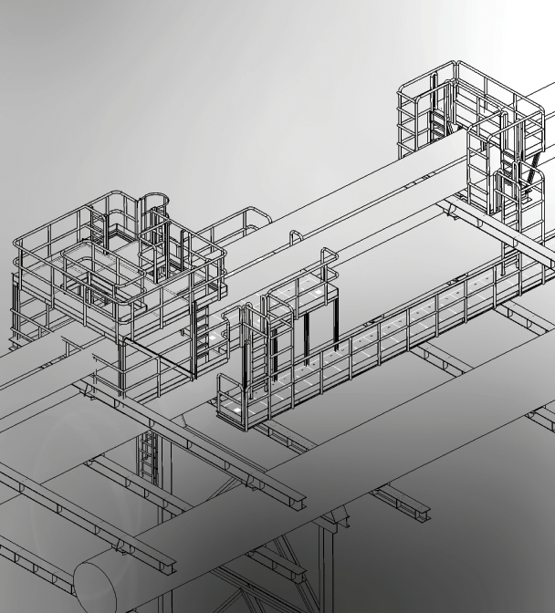
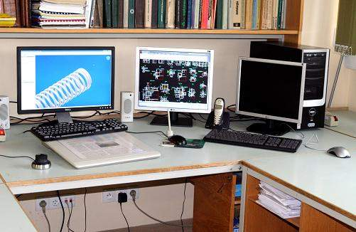
Design Office
The Design Office inside its structure keeps following departments:
• General-mechanical and Crane Department,
• Power Supply and Civil Works Department,
• Electrical Department,
• General-Technical Department.

Slide 15
Design Office
ArcelorMittal Service Group Sp. z o.o. has over 30 years of experience in the field of industrial design. Since its creation in 1975, our designers have developed many projects for the needs of heavy industry.
We specialize in the following projects:
From the mechanical, electrical, power energy and construction industry, and in particular:
modernization of production lines
modernization, reconstruction and repair of hoisting equipment
technological installations in the power industry
dedusting installations
gas and water installations
pressure and supervisory equipment installations
building constructions – structures, halls, industrial sheds
supporting structures of the suspended transportation systems – overtrack travelling cranes, suspended and gantry cranes, hoists
More important realizations carried out recently:
85t BOF for ArcelorMittal Annaba (Algeria)
Modernization of sinter cars for ArcelorMittal Zenica, Bosnia and Herzegovina
Equipment for sheet piles servicing for ArcelorMittal Poland
The first in Poland oxygen pipeline for Air Liquide
Modernization of cranes and adaptation to operate with electromagnets together with Gantry SGM.

Slide 16
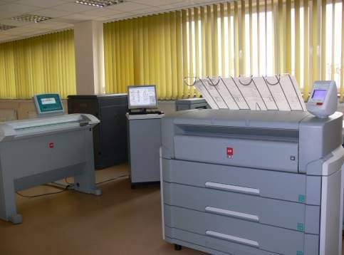
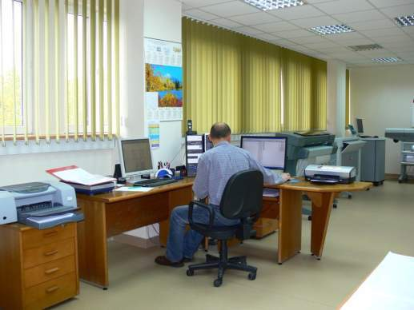
Design Office

Slide 17
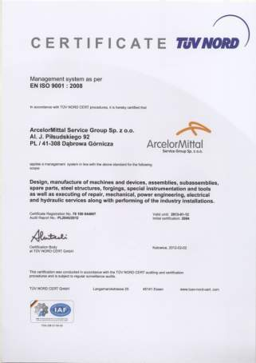
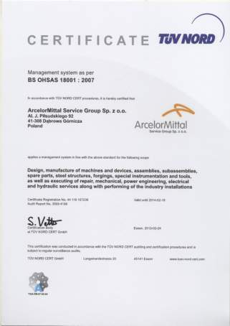
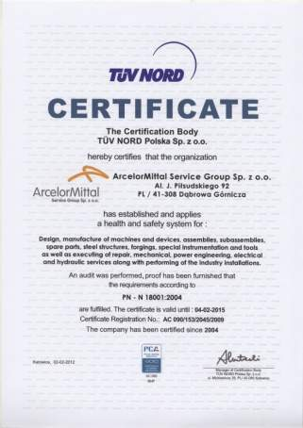
QUALITY ASSURANCE CERTIFICATE

Slide 18
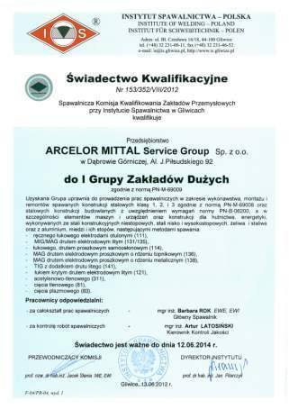
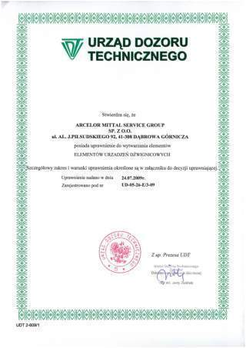
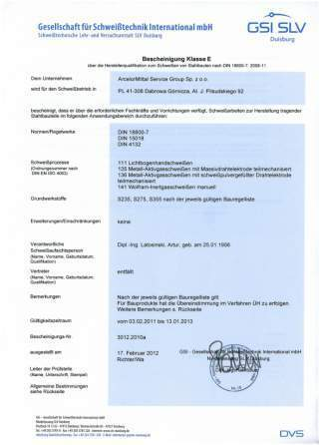
Some of exemplary CERTIFICATES

Slide 19
Examples of realizations

Slide 20
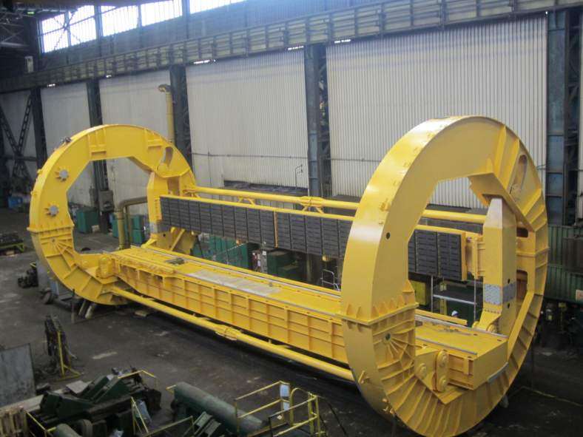
STEEL STRUCTURES – WELDED STRUCTURES
Tilter
Customer: Power Plant Poland

Slide 21
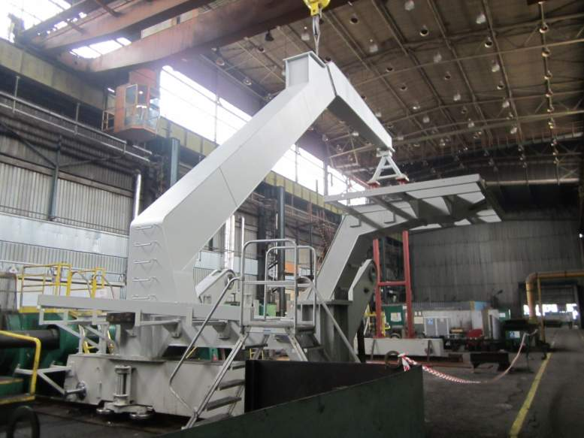
STEEL STRUCTURES – WELDED STRUCTURES
Portal
Customer: Power Plant Poland

Slide 22
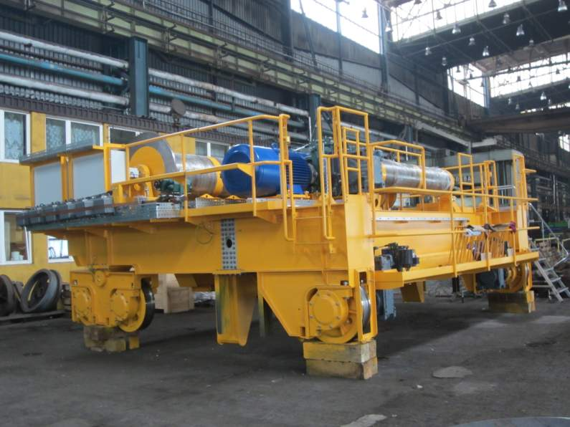
STEEL STRUCTURES – WELDED STRUCTURES

Slide 23
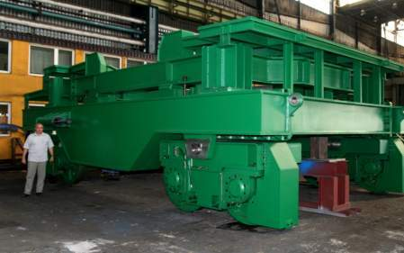
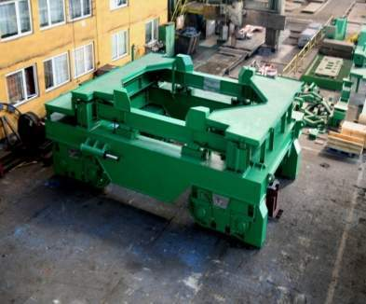
STEEL STRUCTURES – WELDED STRUCTURES
Ladle transfer car
Customer: ArcelorMittal Poland
Ladle transfer cars - for transport of ladles Q200-Q500 Mg, equipped with complete power transmission and steering system, with weighting system (Schenck), heating system and power supply system.
The range of activities covers production of ladle transfer cars together with cooperating systems.
AMSG produces transfer cars for transport of hot metal and steel ladles and two-ladle cars for metallurgical processes.

Slide 24
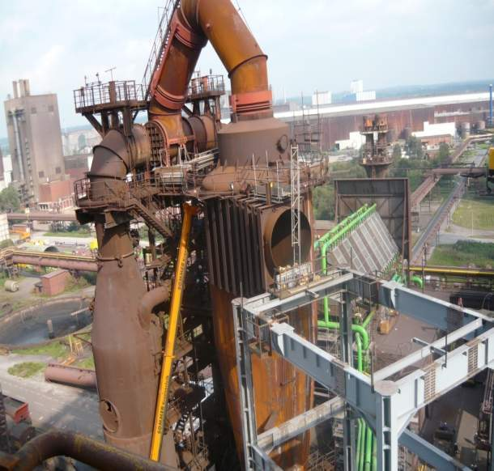
STEEL STRUCTURES – WELDED STRUCTURES
Gas cleaning installation
Customer: ArcelorMittal Bremen
Weigth: 300 000 kg
Diam. 2000 mm x12000 x10mm

Slide 25
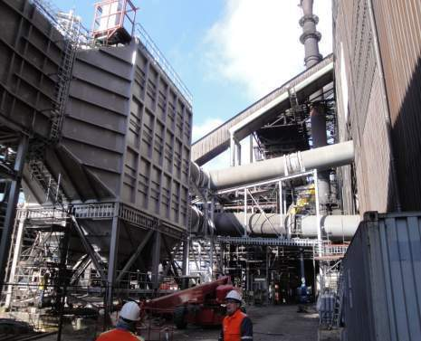
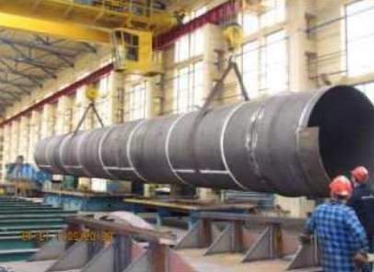
STEEL STRUCTURES – WELDED STRUCTURES
Dedusting pipeline and gas cleaning instalation
Customer: ArcelorMittal Bremen
Weigth: 1 200 000 kg
Gas pipeline
Customer: ArcelorMittal Gent
Diam. 2500 mm
Length: 16000 mm
Thickness: 12 mm

Slide 26
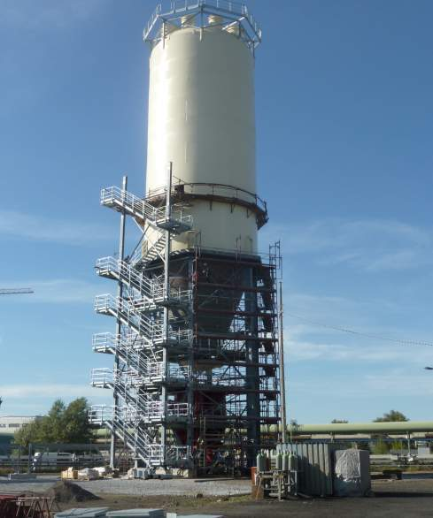
STEEL STRUCTURES – WELDED STRUCTURES
Silo V=1500 m3
Customer:ArcelorMittal Eisenhuttenstadt
Weight: 209 000 kg
Size: 9000 x 45 000 mm
Quantity: 1 pc
Fragment of Trunniong ring

Slide 27
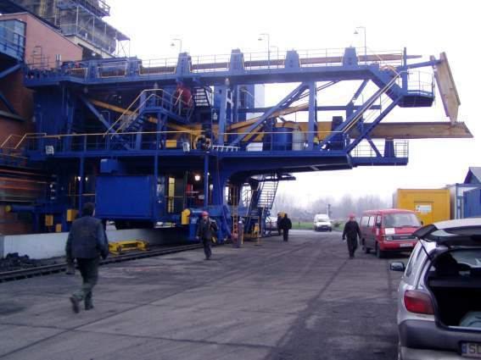
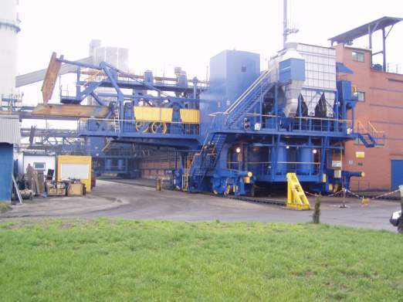
STEEL STRUCTURES – WELDED STRUCTURES
Pushing coke machine
Customer: ArcelorMittal Coke Plant Zdzieszowice

Slide 28
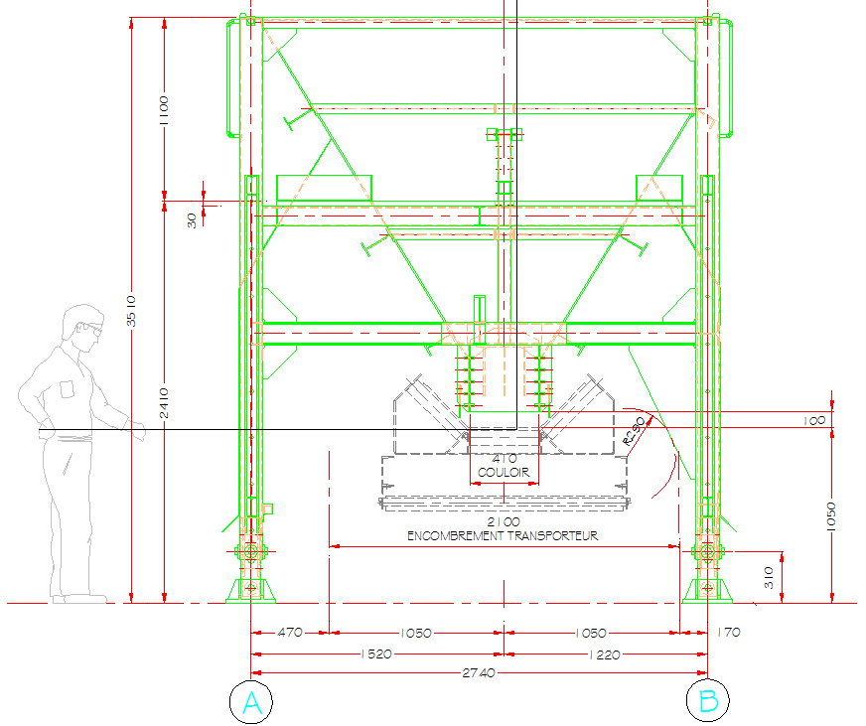
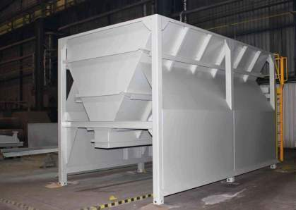
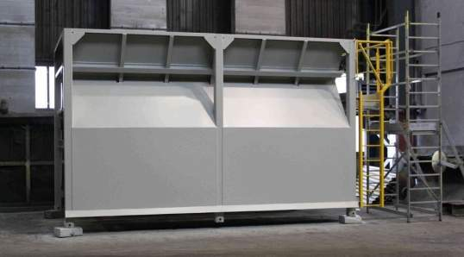
STEEL STRUCTURES – WELDED STRUCTURES
Hoppers
Customer: ArcelorMittal Fos-sur-Mer
Weight: 7 400 kg/pc
Size: 3 510 x 2 740 mm
Quantity: 2 pcs

Slide 29
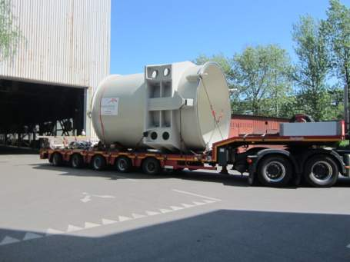
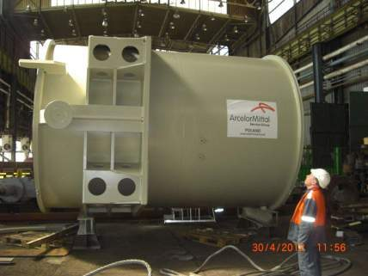
STEEL STRUCTURES – WELDED STRUCTURES
Tank top
Customer: ArcelorMittal Fos
Weight: 20 000 kg
Size: 5 230 x 4 620 x 3 600 mm
Quantity: 1 pcs

Slide 30
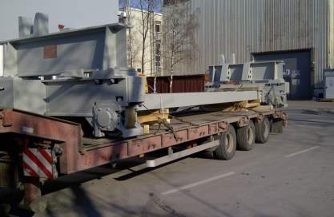
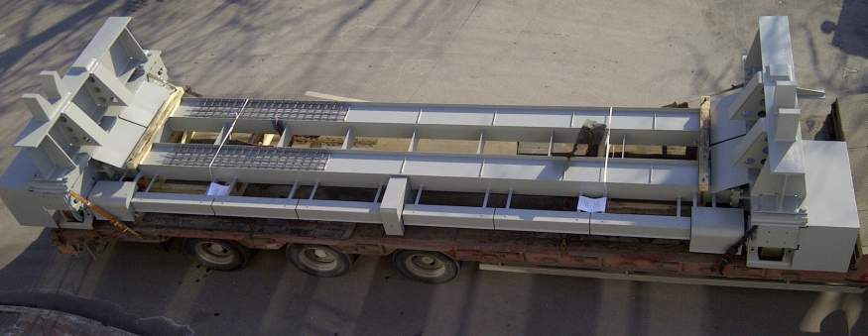
STEEL STRUCTURES – WELDED STRUCTURES
Tundish Car
Customer: ArcelorMittal Kriviy Rih
Weight: 10 025 kg
Size: 9 278 x 2 800 x 1 935 mm
Quantity: 1 pcs

Slide 31
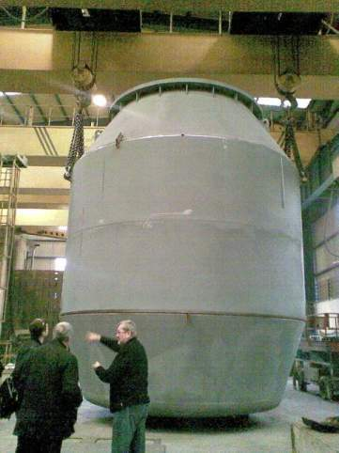
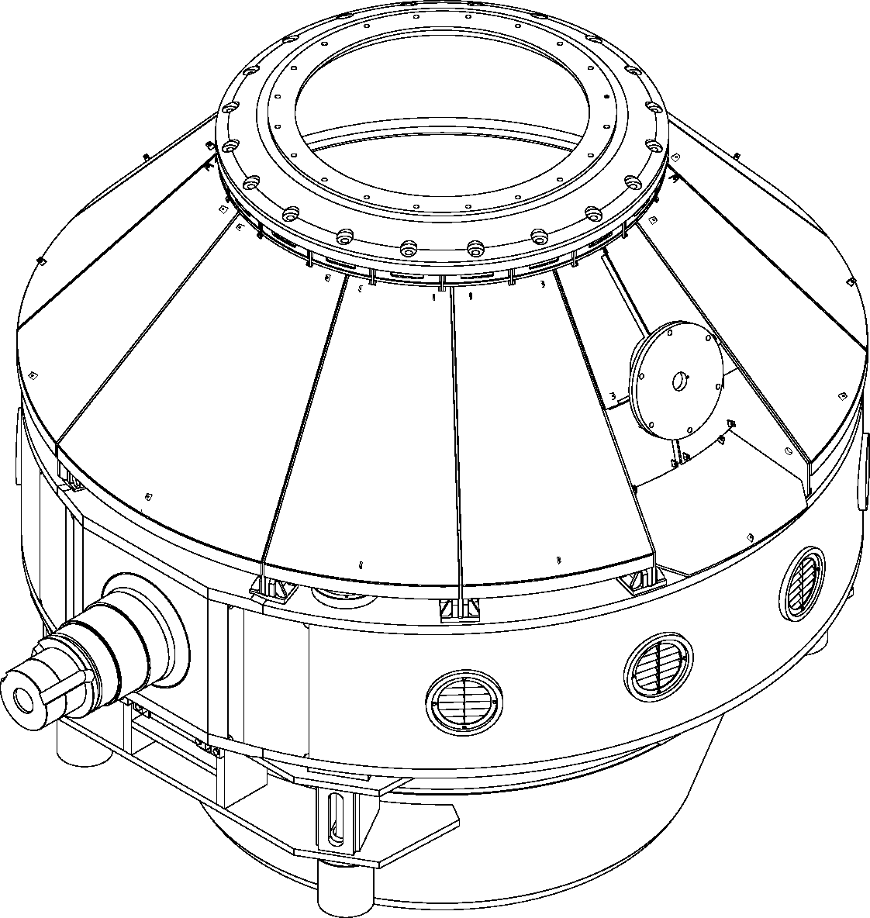
STEEL STRUCTURES – WELDED STRUCTURES
85 t Converter
Customer: ArcelorMittal Annaba
Weight: 201 250 kg
Capacity: 76.6 m3
Size: 7 700 x 5 600 mm (ring10 000 mm)
Quantity: 2 pcs
Fragment of Trunniong ring

Slide 32
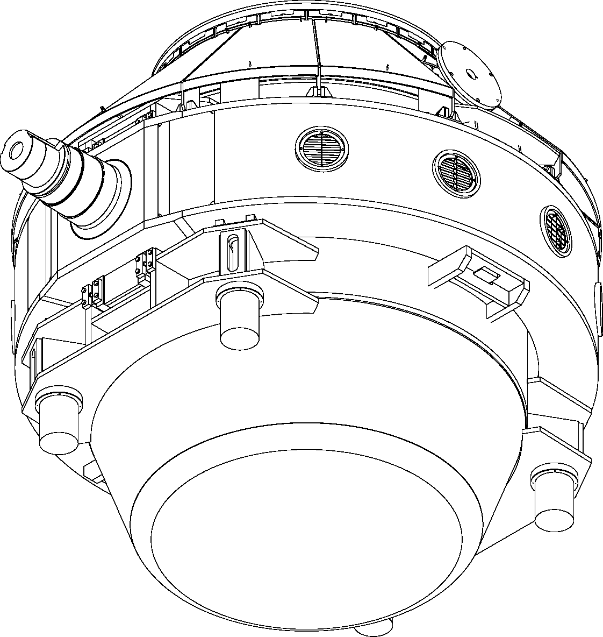
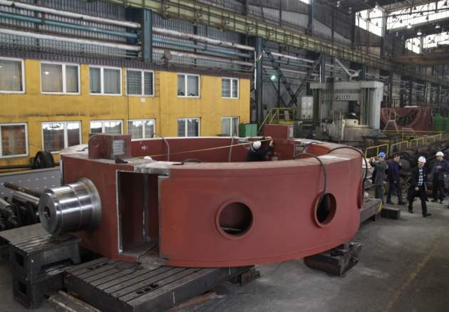
TRUNNION RING – AM ANNABA

Slide 33
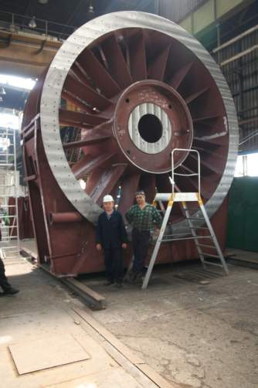
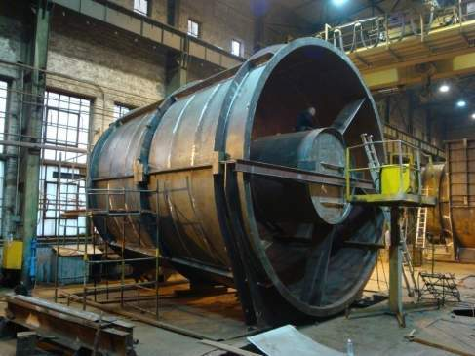
STEEL STRUCTURES – WELDED STRUCTURES
Fan Housing and Diffusor
Customer: Howden Ventilatoren GmbH, Germany
Weight: 220 000 kg
Size: diam. 5 500 mm
Quantity: 2 sets

Slide 34
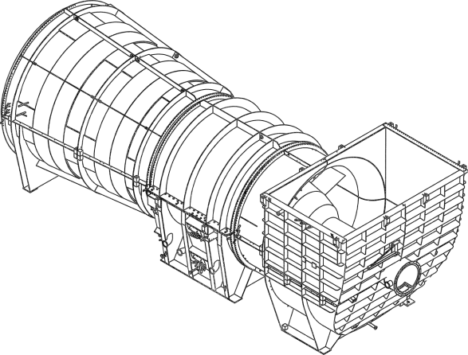
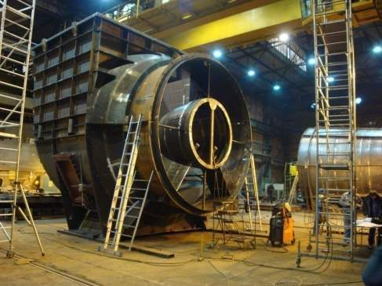
STEEL STRUCTURES – WELDED STRUCTURES
Inlet box
Customer: Howden Ventilatoren GmbH
Weight: 99600 kg
Size: diam. 6 500 mm, length: 19 000 mm
Quantity: 2 pcs

Slide 35
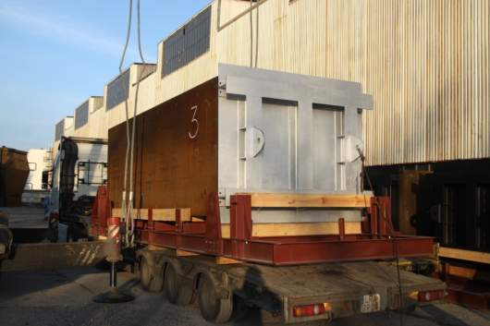
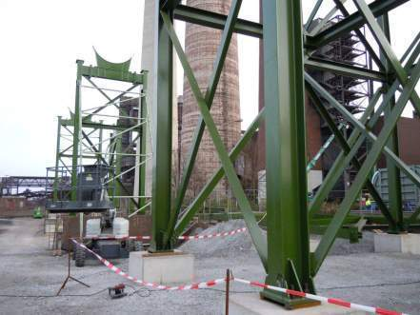
STEEL STRUCTURES – WELDED STRUCTURES
Radiators
Customer: ArcelorMittal Florange
Weight: 25 000 kg
Size: 2 000 x 6 000 x 2 000 mm
Quantity: 21 pcs
Supporting structures for dedusting installation
Customer: ThyssenKrupp Uhde
Weight: 715 000 kg
35
Notes:
35

Slide 36
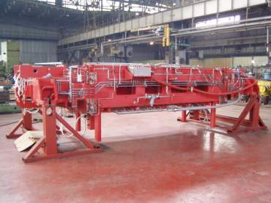
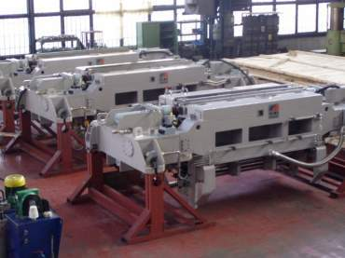
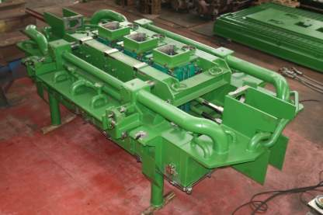
STEEL STRUCTURES – MACHINED PARTS
Continuous casting moulds
Customer: Siemens VAI
SMS Demag
ISD Huta Częstochowa
AM Service Group Sp. z o.o. is specialized in production of continuous casting moulds
According to technology from: Simens VAI, SMS Demag
AMSG can also offer: regeneration, spare parts, assemblies, maintenance

Slide 37
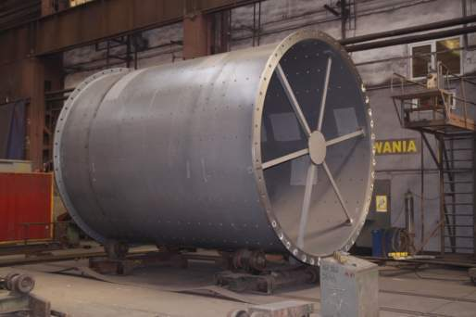
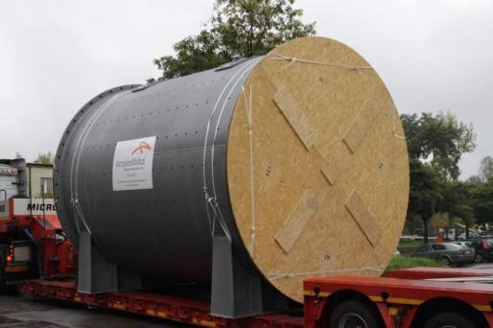
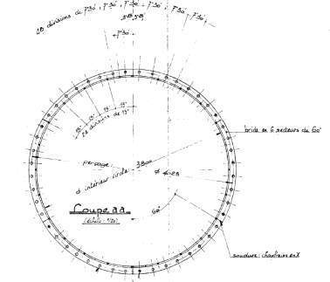
STEEL STRUCTURES – MACHINED PARTS
Drums
Customer: ArcelorMittal Lazaro, Mexico
Size: diam. 4 000 mm, length: 5 500 mm
Quantity: 2 pcs

Slide 38
STEEL STRUCTURES – MACHINED PARTS
Cooling Table
Customer: ArcelorMittal Gandrange
Weight: 176 000 kg
Size: ~7m long
Quantity: 1 set
38
Notes:
38

Slide 39
STEEL STRUCTURES – MACHINED PARTS
CCM rolls
Customer: ArcelorMittal Poland
ArcelorMittal Temirtau
Length: 500 – 1500 mm
Diameter: 150 – 300 mm
AMSG produces CCM rolls in the diameter of Ø150-Ø300 with overlaying coat of high fatigue resistance (Chromocore type), length 500-1500 mm, and stainless steel rolls (3H13 class) thermally improved.

Slide 40
STEEL STRUCTURES – MACHINED PARTS
ArcelorMittal Service Group Sp. z o.o. offers rolls for the Continuous Casting Segments for flat, squared and rectangular slabs.
ArcelorMittal Service Group is also a manufacturer of rolls for tables, feeding devices and profile rollers for straightening devices.

Slide 41
STEEL STRUCTURES – MACHINED PARTS
Sheet coating line
Customer: ArcelorMittal Poland

Slide 42
Saw blades hot and cold cutting
CONSUMABLES
For 35 years, the saw blades for hot and cold cutting are manufactured according to own unique solutions. Thanks to the use of the special steel grade, and the heat treatment the saw blades are characterized by very good operational qualities, high cutting edge resistance, resistance to cracks – all these features allow obtaining a very good roughness of the surfaces cut. Noise emission during cutting is quite low.
The saw blades are perfect tool for cutting hot and cold rolled steel products such as, sections, rails, pipes and bars within the technological lines of the rolling mill. The Company produces a very wide variety of saw blades with diameter from 600 mm to 2100 mm, teeth distance from 8 mm to 22 mm and blade thickness from 6 mm to 12 mm.

Slide 43
CONSUMABLES
Saw blades
Customer: ArcelorMittal Poland
Koma, Czech Republic
diameter = 600 – 2100 mm
blade thickness = 6 – 12 mm
teeth distance = 8 – 22 mm
Teeth hardened superficially
Teeth parameters acc. to the customer requirements

Slide 44
Moulds and strand guide segments for the CCM
CONSUMABLES
Manufacturing and regeneration of plate moulds, continuous casting moulds and strand guide segments for bow continuous casting machines require mechanical working of the exact accuracy. There are two different plate moulds manufactured: the one of size 280x300 mm and the second of size 280x400 mm. The starting material for the moulds’ plates is copper – Cu with addition of silver - Ag. Optionally the moulds’ plates can be prepared as hardened by galvanizing with chromium – Cr or nickel – Ni layer to increase their lifetime. The moulds’ plates have the curvature radius of R=12000 mm. The mechanical working of the moulds’ plates takes place exclusively using the special CNC machines according to the computer software along 3 or 5 coordinates.
The accuracy of manufacturing as well as dimensions repeatability is proved with test measurements using CNC measurement machine.

Slide 45
Scrap buckets for AM Bremen 5pcs. X 24T=120T

Slide 46
Scrap buckets for AM Bremen

Slide 47
Scrap buckets for AM Bremen

